Slide 1

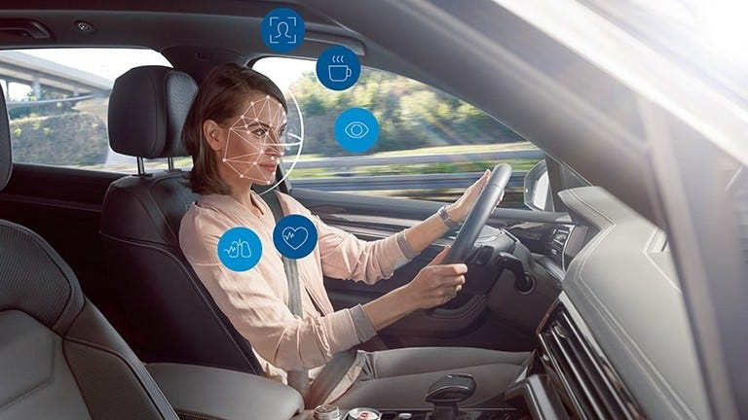
Facial Features Based Drowsiness Detection with Multi scale Convolutional Neural Network
Under the Guidance of:
DR. Prabaharan L
Asst. professor
Presented by:
125003148 Kevin M
125003287 Sanju S
125003321 Sibikiran V

Slide 2
LAYOUT OF THIS PRESENTATION
Motivation
Objective
Base Paper
Problem Statement
Literature Survey
Modules
Dataset
Proposed Techniques
Reference

Slide 3
MOTIVATION
Drowsy driving poses a significant risk to road safety, contributing to a substantial number of accidents and fatalities worldwide. By developing effective drowsiness detection systems, we have the opportunity to prevent tragic accidents, save lives, and protect the well-being of drivers, passengers, and pedestrians.
Drowsy driving accidents not only result in loss of life but also lead to injuries, disabilities, and long-term health consequences for those involved. By addressing the issue of drowsy driving, we can reduce the burden on healthcare systems, improve public health outcomes, and alleviate the physical and emotional toll of accidents.
Implementing drowsiness detection systems in vehicles enhances road safety by alerting drivers at risk of drowsy driving, mitigating fatigue-related dangers, and preventing accidents for safer roads worldwide.

Slide 4
OBJECTIVE
To develop a robust drowsiness detection system leveraging a Multi-Scale Convolutional Neural Network (MCNN) framework integrated with the Flamingo Search Algorithm (FSA). The aim is to effectively identify and classify drowsy and non-drowsy states in drivers using video sequences from the YAWDD and NTHU-DDD datasets.
The project involves keyframe extraction, facial point localization with the Dlib library, and pre-processing techniques such as Cross Guided Bilateral Filtering. Feature extraction utilizing hybrid dual-tree complex wavelet transforms with Walsh-Hadamard transform is applied, followed by optimization with the FSA algorithm.
The primary objective is to enhance road safety by detecting drowsiness accurately and efficiently, thereby preventing accidents and promoting safer driving conditions.

Slide 5
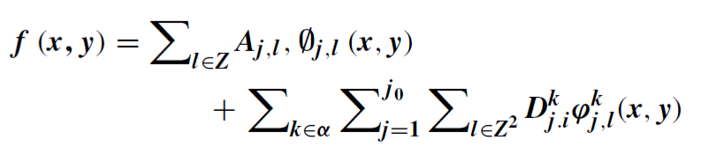
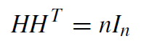
BASE PAPER
V Vijaypriya, Mohan Uma, “Facial Feature-Based Drowsiness Detection With
Multi-Scale Convolutional Neural Network”
Link: https://ieeexplore.ieee.org/document/10158440
In this paper, the following equation of complex wavelet function and Hadamard matrix are used for the Feature Extraction Process.

Slide 6
PROBLEM STATEMENT
The recent increase in accidents attributed to driver drowsiness, stemming from factors such as insufficient sleep, fatigue, and underlying health issues, poses a significant threat to public safety. Drowsiness while driving not only leads to loss of life, property damage, and serious health complications but also contributes to a substantial number of accidents worldwide.
Despite the effectiveness of existing automated models in detecting and recognizing drowsiness, there remains a pressing need to further enhance the prevention of accidents caused by driver drowsiness.

Slide 7
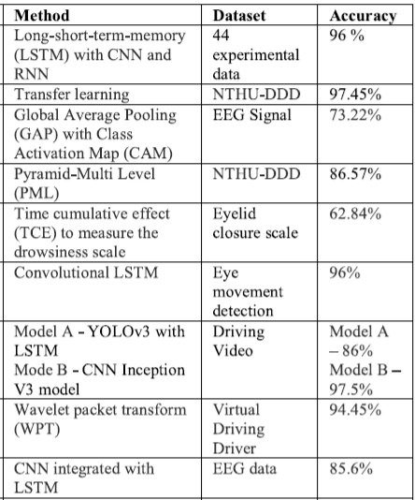
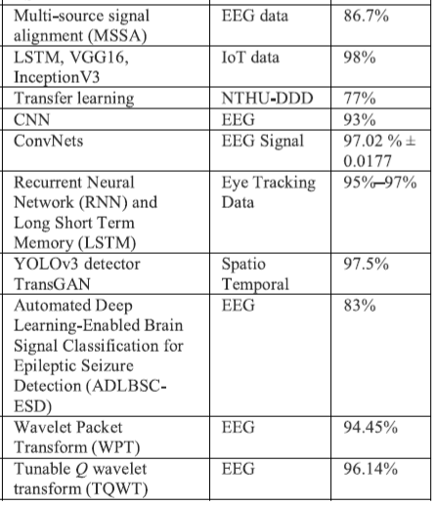
LITERATURE REVIEW

Slide 8
LITERATURE SURVEY
LSTM with CNN & RNN
44 experimental data
96% accuracy
Transfer learning
NTHU-DDD
97.45% accuracy
LSTM, VGG16, InceptionV3
IoT data
98% accuracy

Slide 9
MODULES
Dataset
Key Frame Extraction & Selection
Preprocessing
Cross Guided Bilateral filtering
Feature Extraction
Hybrid dual-tree complex wavelet transforms with Walsh-Hadamard transform
MCNN Model

Slide 10
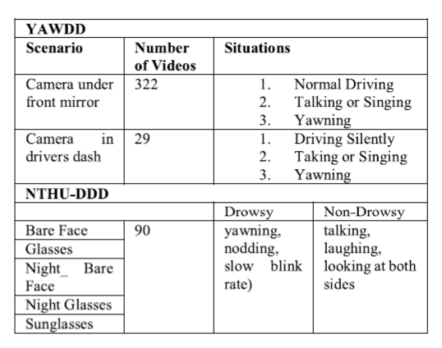
DATA SET
YAWDD dataset – Yawning Detection Dataset
NTHU-DDD dataset - National Tsing Hua University Drowsy Driving Detection dataset

Slide 11
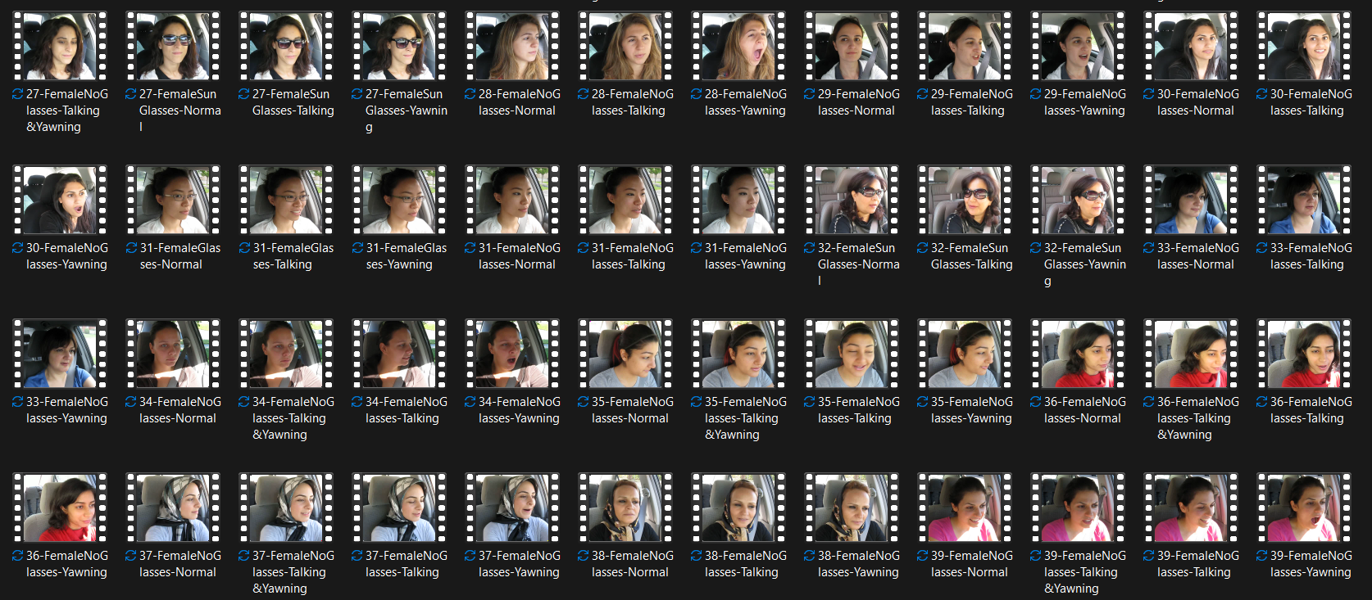
YAWDD

Slide 12
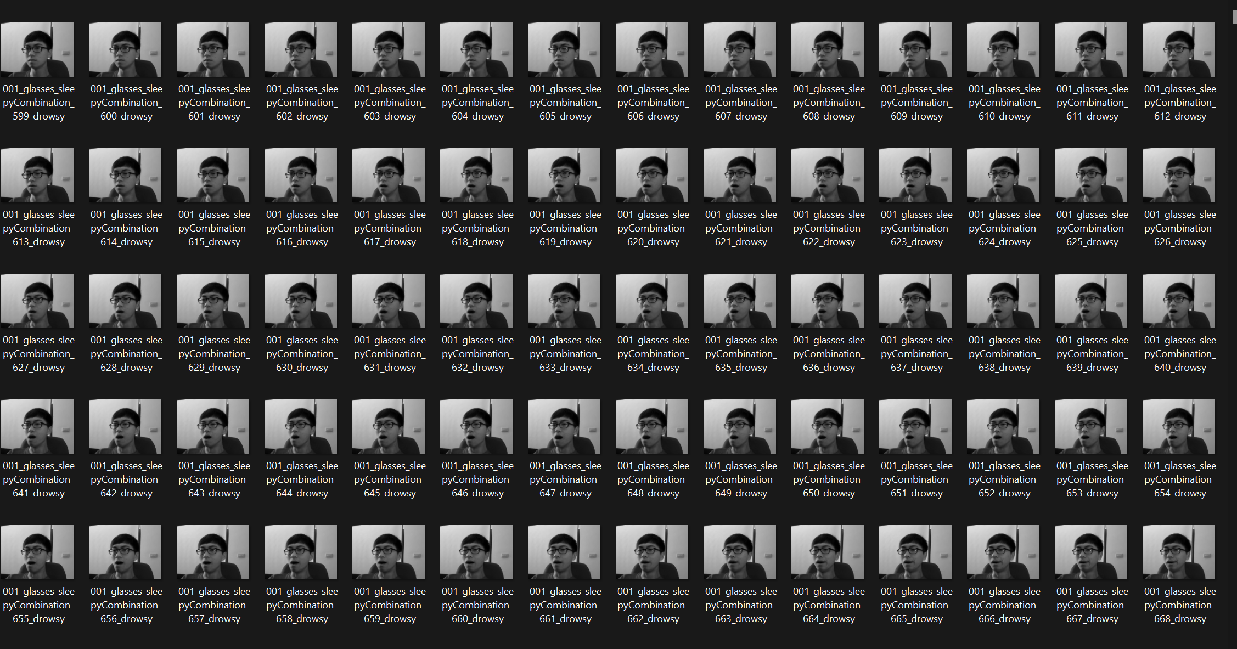
NTHU-DDD

Slide 13
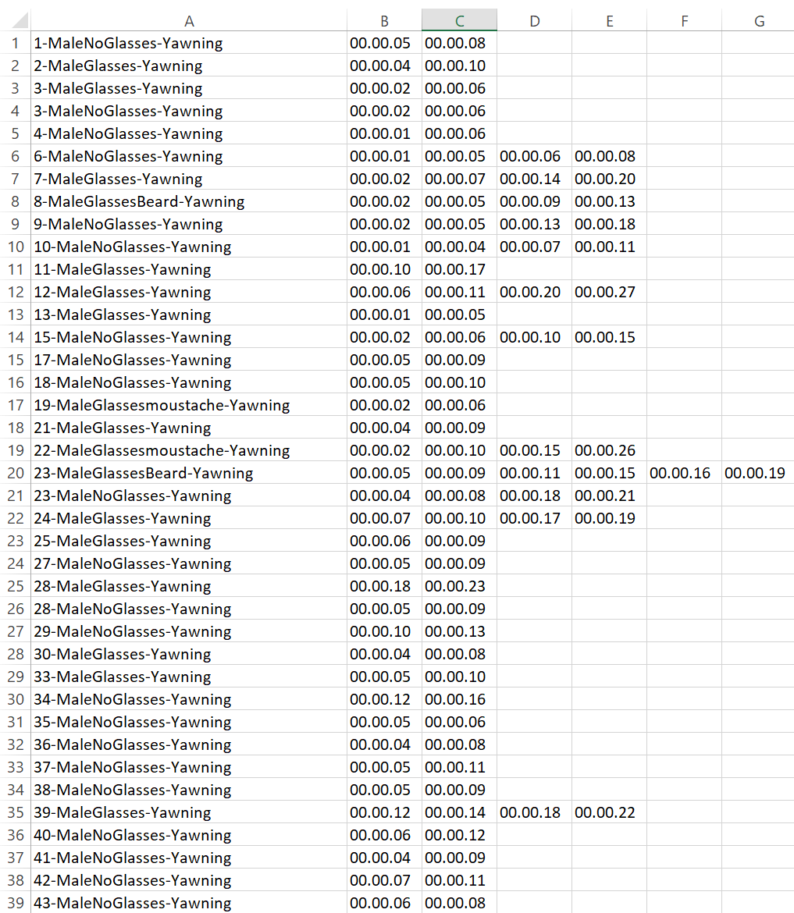
DATASET CLASSIFICATION

Slide 14
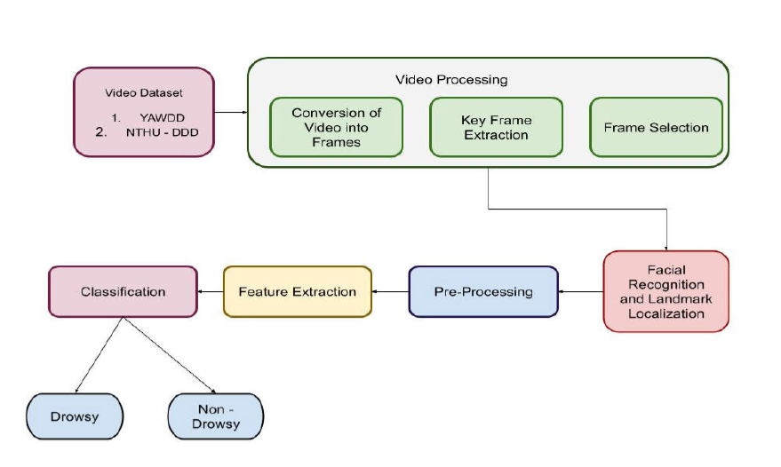
PROPOSED TECHNIQUES (ARCHITECTURE)

Slide 15
KEY FRAME EXTRACTION AND SELECTION
The selected dataset video sequences are converted into frames. After the conversion of the video into frames key frames are extracted and selected. Those key frames provide the overall summary of the frames in the video sequences.
As the key frames are selected in the frames the facial landmarks such as eyes and mouths are identified.

Slide 16
KEY FRAME EXTRACTION AND SELECTION
Import cv2, dlib and os modules
Use cv2.VideoCapture() to read an input video , read() to read each frame present in the video
Set an interval (3) to extract every 3rd frames (0,3,6…)
Use dlib‘s "shape_predictor_68_face_landmarks.dat“ model to detect face
Select only the frames which has detected facial landmarks using the above model
Use cv2.imwrite(path,frame) to write the frame in the required path

Slide 17
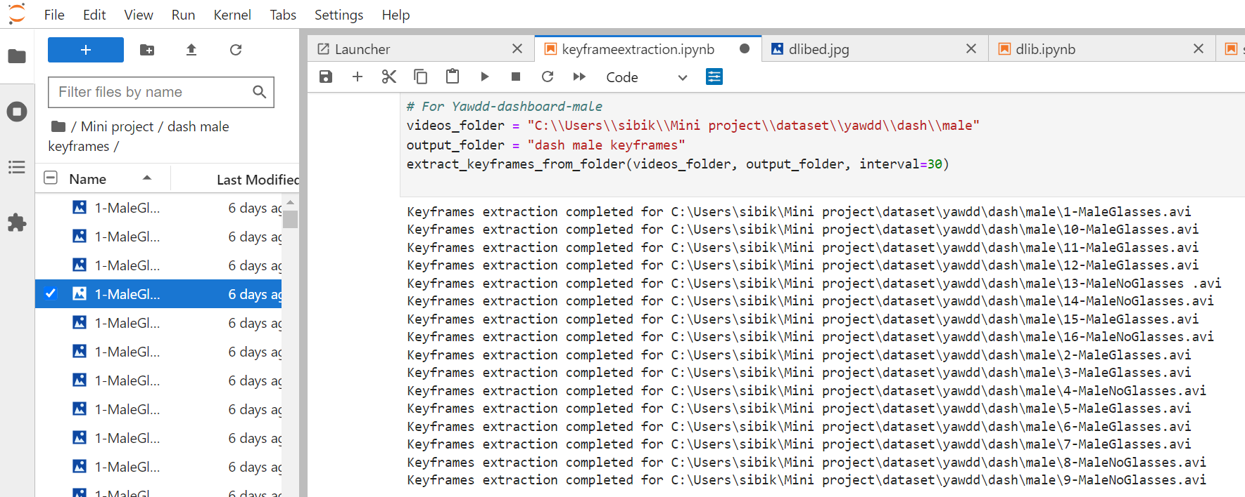
KEY FRAME EXTRACTION AND SELECTION

Slide 18
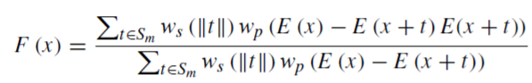
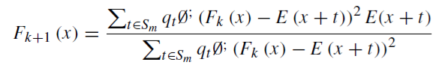
PRE PROCESSING
Cross Guided – Bilateral Filter
The cross guided bilateral filter enhances traditional image smoothing and noise reduction by incorporating guidance from a separate image.
- (1)
- (2)
- (3)

Slide 19
PRE PROCESSING
Import cv2 , dlib & numpy
For guidance image convert the original image to its grayscale form (cv2.cvtColor())
Create a mask to exclude the face region using dlib and numpy’s ones_like()
Use cv2.ximgproc.guidedFilter(guidance_image, target_image, diameter, sigma_color, sigma_space) to apply cross guided bilateral filter
Apply filter to grayscale image , and then to non face region using inverse mask
Combine these two filtered images to get the desired image.

Slide 20
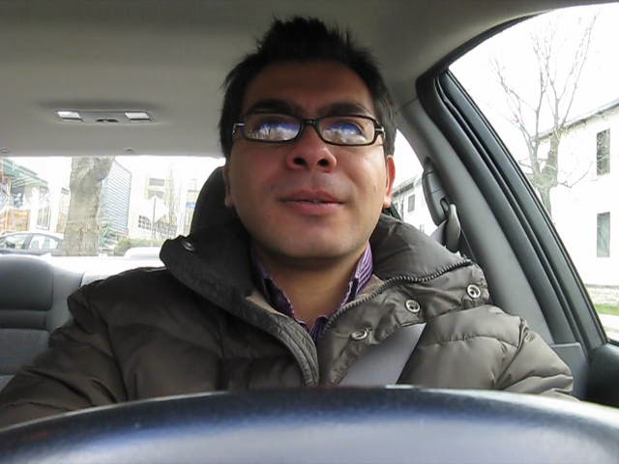
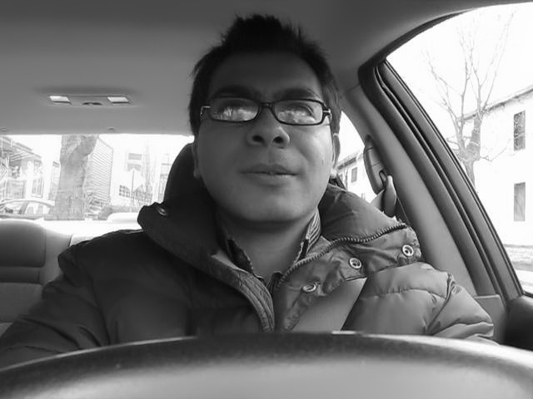
PRE PROCESSING

Slide 21
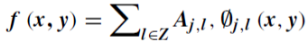
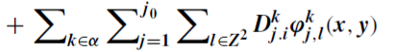
FEATURE EXTRACTION
To construct an effective model with minimal effort feature extraction is considered the effective approach to reducing the redundant data.
The Dual-Tree Complex Wavelet Transform (DTCWT) is a sophisticated signal processing method used for feature extraction in image analysis. By employing complex-valued wavelet functions and utilizing two separate tree structures, DTCWT offers enhanced directional selectivity and captures both magnitude and phase information of image features. This makes it particularly effective for extracting detailed and comprehensive features from images.

Slide 22
FEATURE EXTRACTION
Import dtcwt
Using dlib library find the facial landmarks and store it in numpy array
Convert the image to grayscale using cvtColor()
Use dtcwt’s Transform2d() to initialize the dtcwt
Use Transform2d’s forward(gray,nlevels) [nlevel=3] to compute the coefficients
Compute energy features using coeffs.highpasses
Use the above steps to find the features for the eyes and mouth

Slide 23
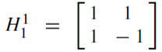
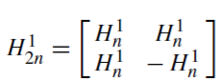
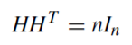
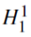
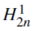
FEATURE EXTRACTION
The Walsh-Hadamard Transform (WHT) is a feature extraction technique utilized in pattern recognition and image analysis. Operating on binary input sequences, where each element is either +1 or -1, it transforms them into coefficients, capturing crucial data characteristics.
By leveraging the orthogonality of Walsh functions, it efficiently compresses information, making it suitable for tasks like pattern recognition and feature extraction across diverse domains.
Here is the minimal Hadamard kernel and is the higher order of the hybrid DTCWT Hadamard kernel.

Slide 24
FEATURE EXTRACTION
Use the extracted feature’s from dtcwt
Pad the input data with zeros to the next power of 2
Convert the input data into a NumPy array and checks if the length is 1, returning the input if true.
If the length is greater than 1, divide the data into two halves and calculate the even sum and odd difference.
Recursively apply the WHT on the even sum and odd difference separately.
Finally, concatenate the transformed lower and upper halves and return the result.

Slide 25
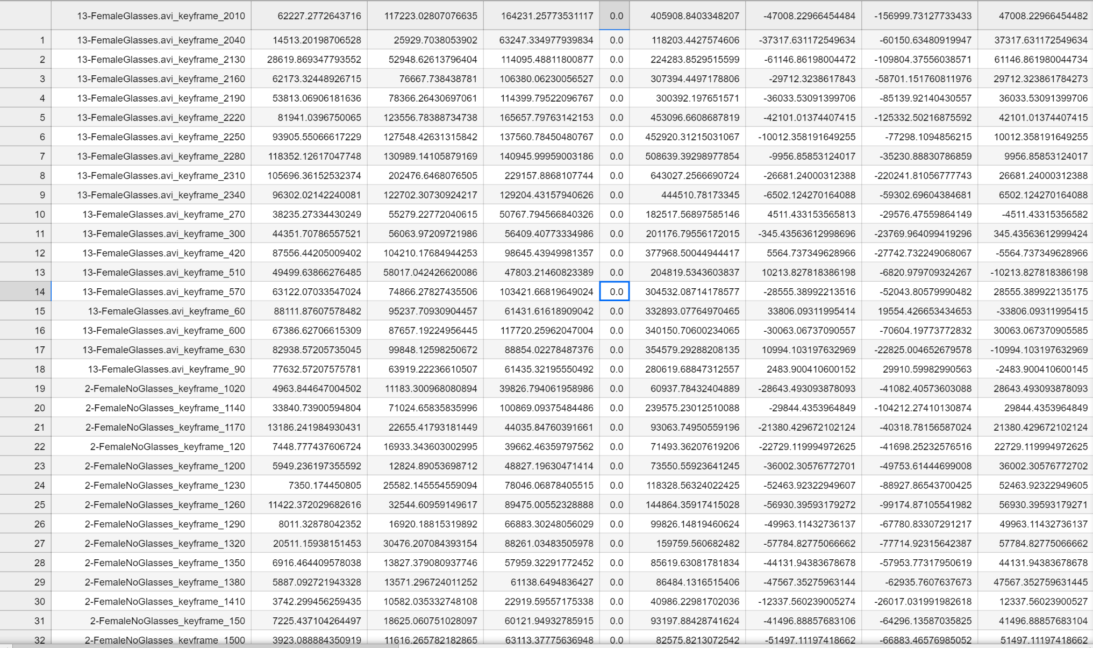
FEATURE EXTRACTION

Slide 26
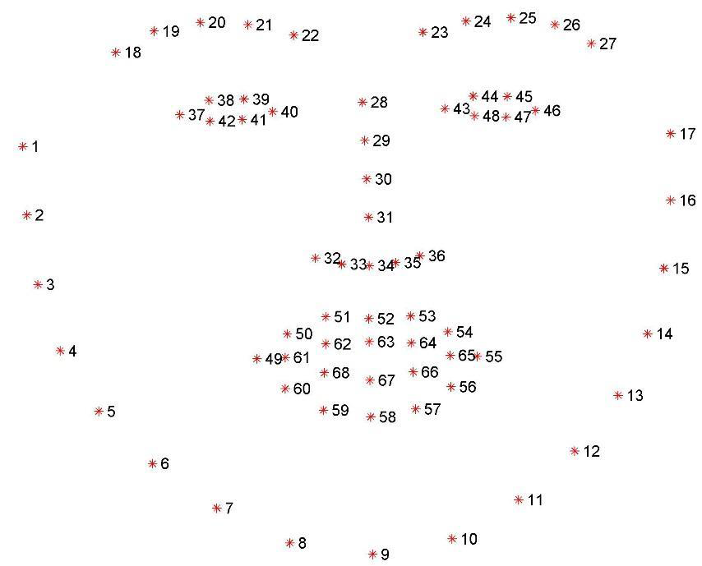
DLIB
shape_predictor_68_face_landmarks.dat

Slide 27
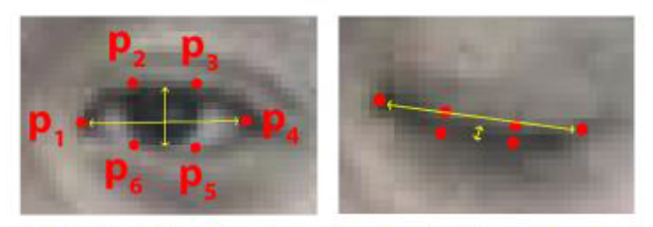
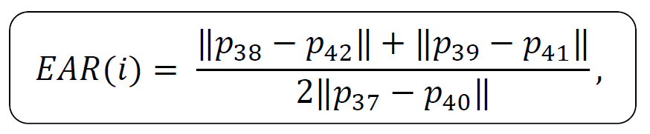
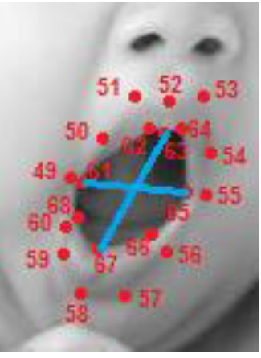
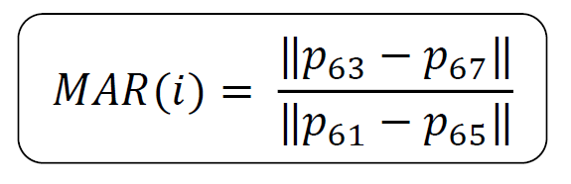
ADDITIONAL FEATURES
Eye Aspect Ratio (EAR):
Mouth Aspect Ratio (MAR):

Slide 28
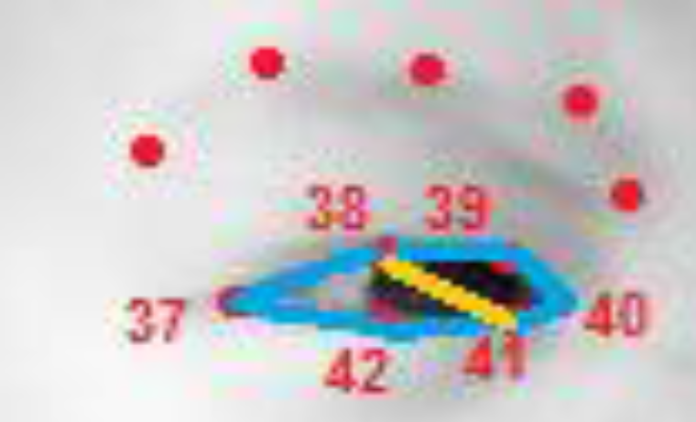
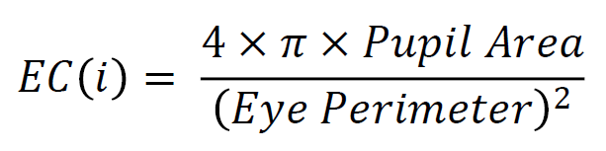
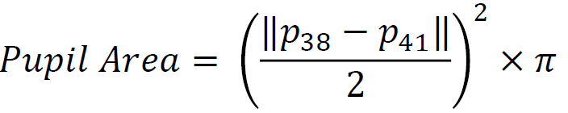
ADDITIONAL FEATURES
Eye Circularity (EC):

Slide 29
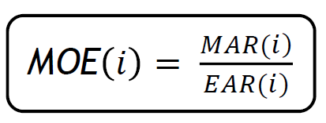
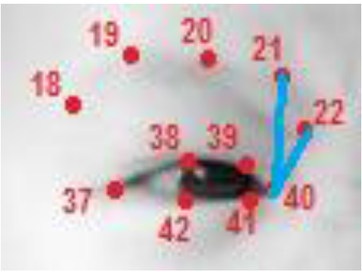
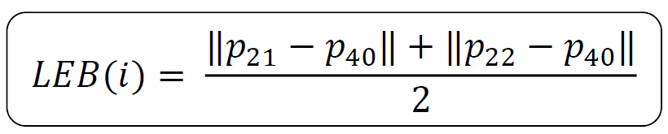
ADDITIONAL FEATURES
Mouth Over Eye (MOE):
Level of Eyebrows (LEB):

Slide 30
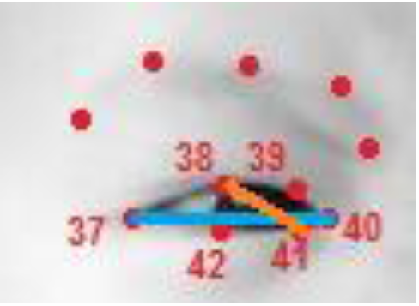
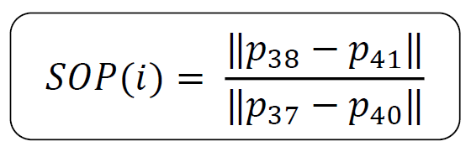
ADDITIONAL FEATURES
Size Of Pupil (SOP):

Slide 31
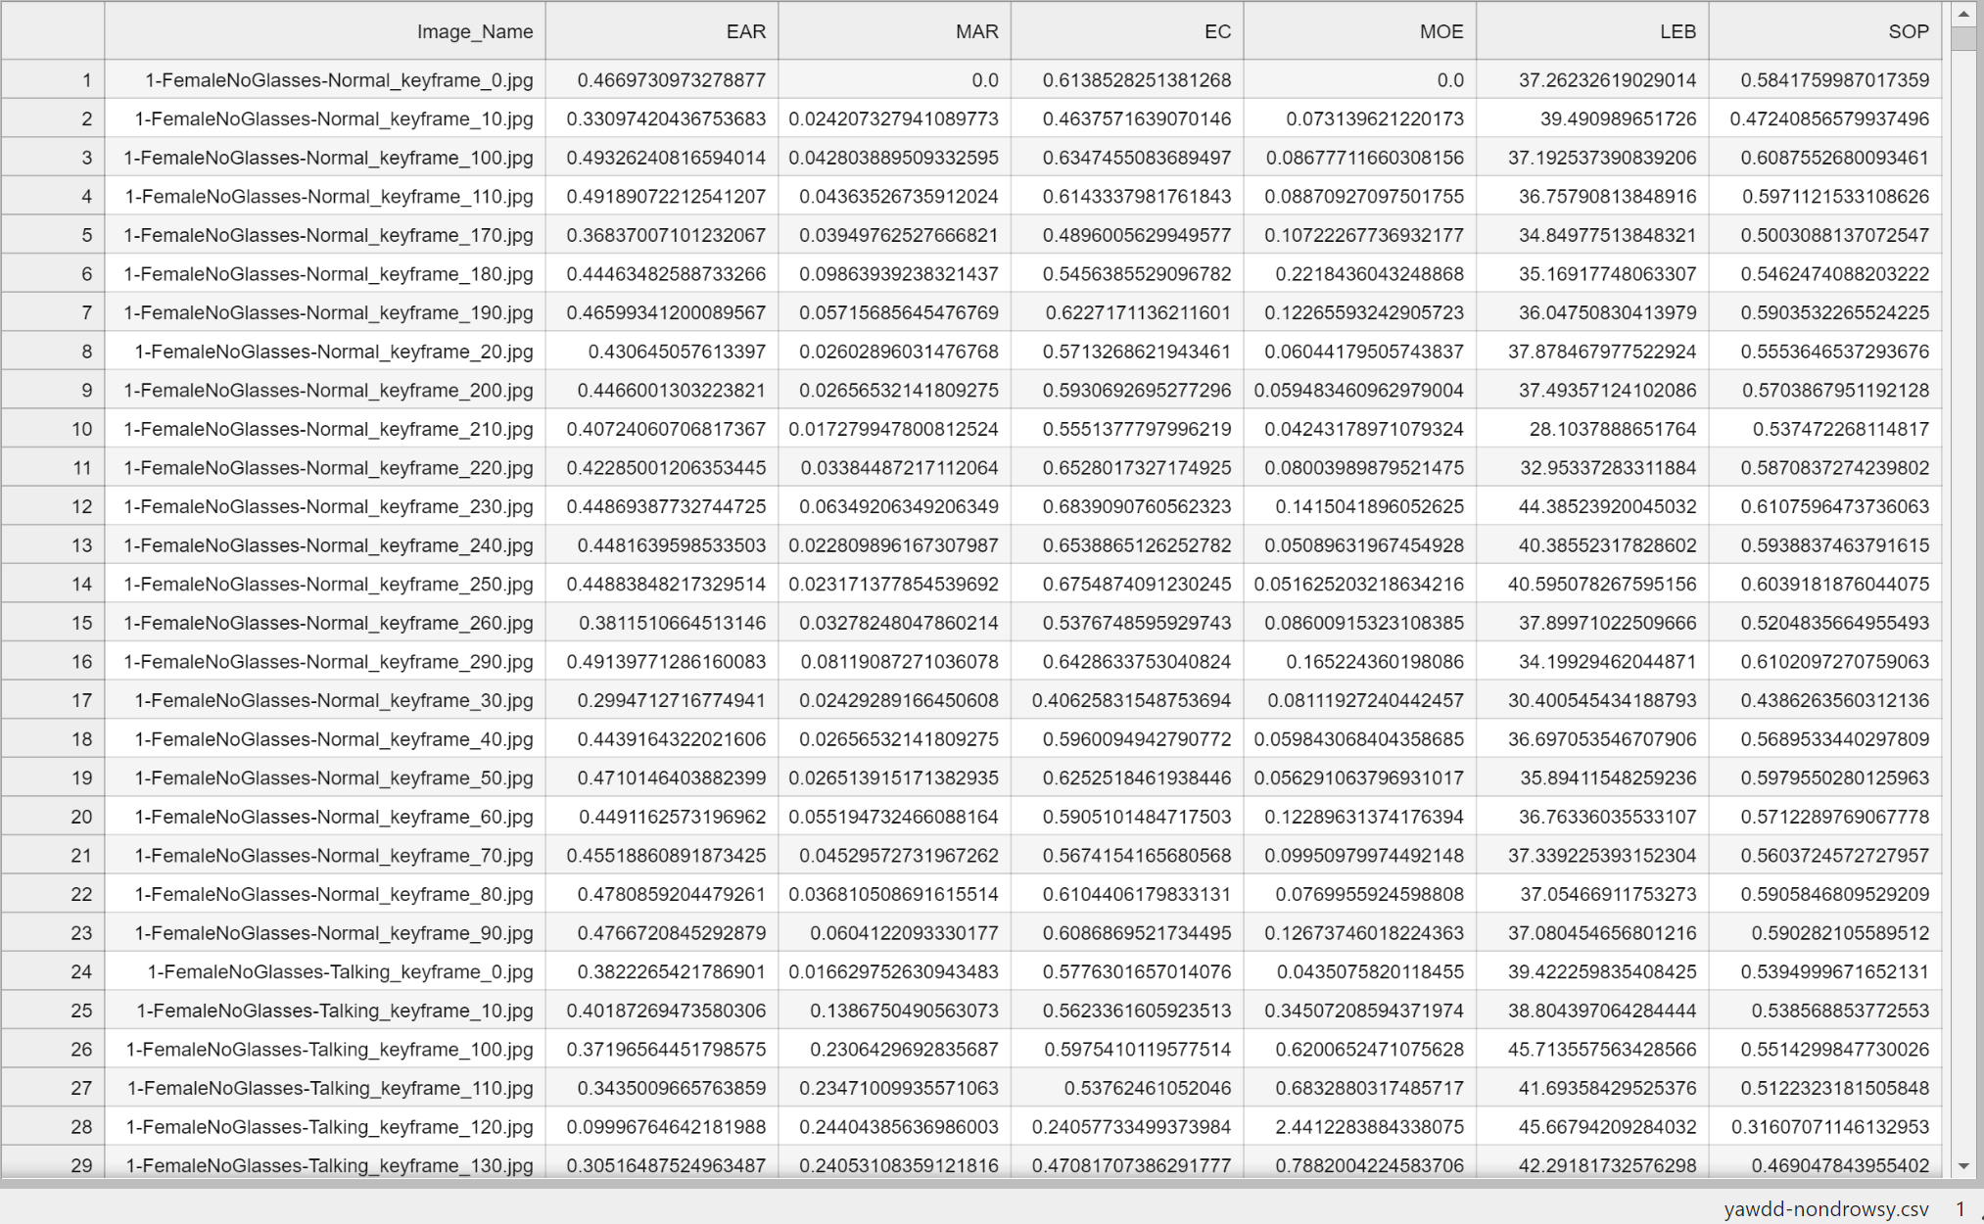
ADDITIONAL FEATURES OUTPUT

Slide 32
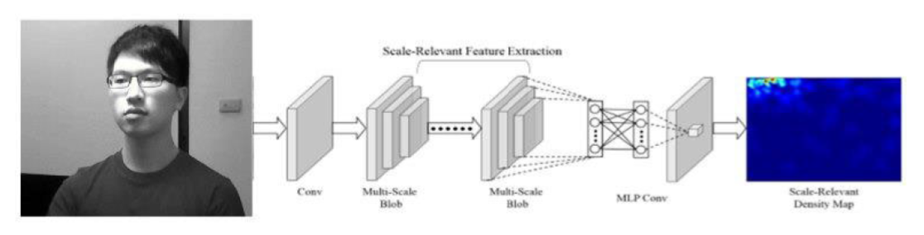
MCNN- MULTISCALE CONVOLUTION NEURAL NETWORK
MCNN is a powerful tool for pattern recognition in drowsiness detection tasks.
It utilizes convolutional and pooling layers for feature extraction.
Fully connected layers enable final classification.

Slide 33
Model Outputs
NTHUDDD
Accuracy : 98.80%
Confusion Matrix : [[5748, 43], [111, 6951]]
Precision : 0.99 , Recall : 0.98 , F1 score : 0.99 , Kappa Score : 0.98
YAWDD
Accuracy : 99.12%
Confusion Matrix : [[1869, 10], [11, 505]]
Precision : 0.98 , Recall : 0.98 , F1 score : 0.98 , Kappa Score : 0.97

Slide 34
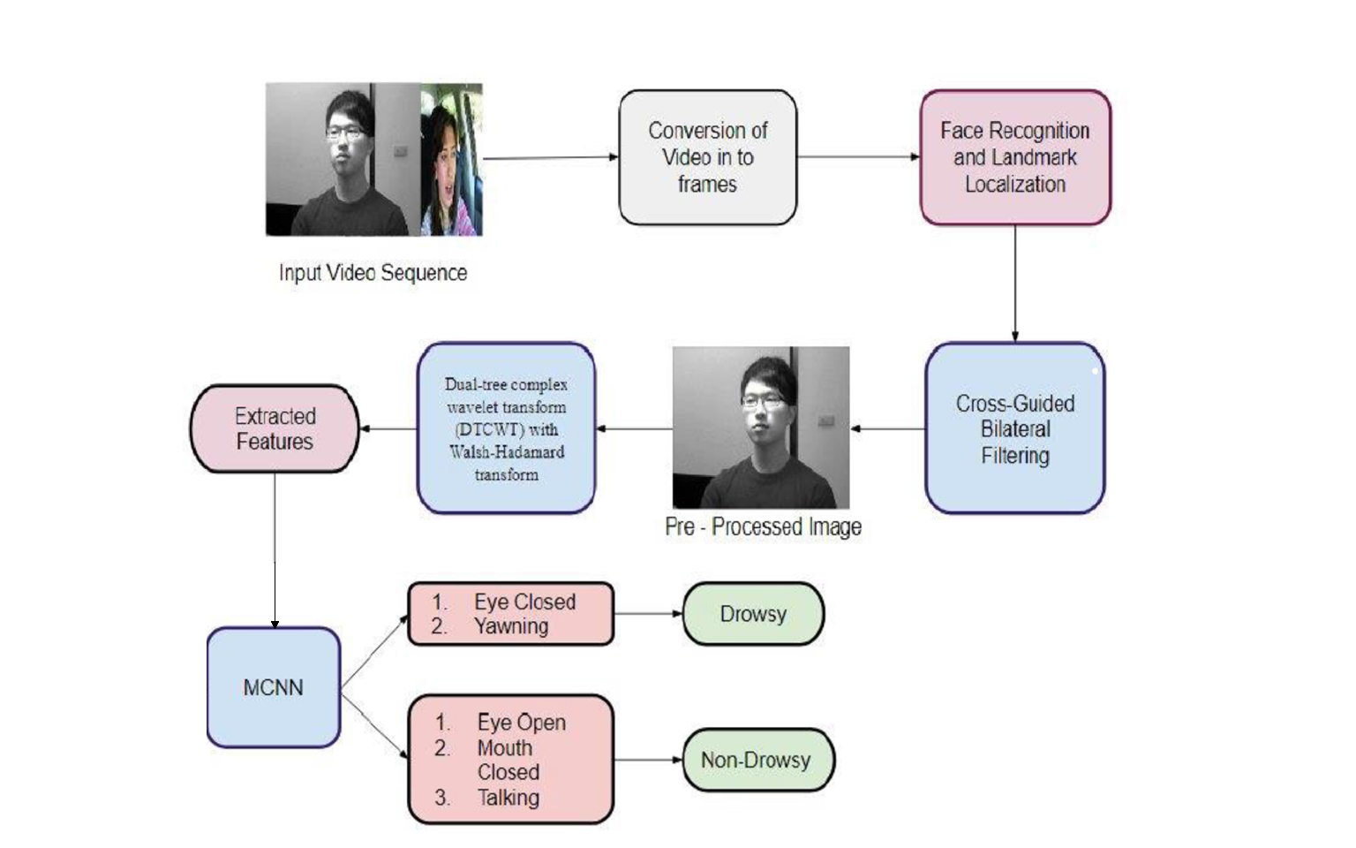
OVERALL VIEW

Slide 35
FSOA
The Flamingo Search Algorithm (FSA) is a bio-inspired optimization algorithm inspired by the foraging behavior of flamingos. It mimics the strategies employed by flamingos in searching for food sources in their natural habitat.
Foraging Behaviour
Communication Behaviour
Beak scanning Behaviour
Bipedal mobile Behaviour
Migration Behaviour
Population Migration

Slide 36
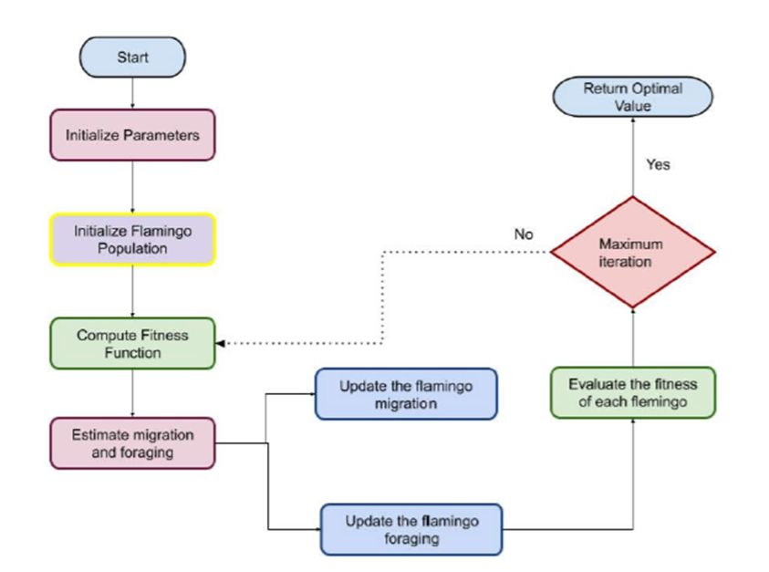
FSOA

Slide 37
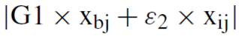
FSOA
Initialize the required parameters (dimensions, population size, max iteration)
Define fitness function based on MCNN performance
Iterate through max iteration and population size to update the position of the flamingo based on two operations
Beak scanning behaviour
Bipedal movement

Slide 38
REFERENCES
[1] Y. K. Arora and S.Kumar, ‘‘Statistical approach to predict road accidents in India,’’ in Computing in Engineering and Technology. Singapore: Springer,2020, pp. 189–196.
[2] E. Magán, M. P. Sesmero, J. M. Alonso-Weber, and A. Sanchis, ‘‘Driver drowsiness detection by applying deep learning techniques to sequences of images,’’ Appl. Sci., vol. 12, no. 3, p. 1145, Jan. 2022.
[3] S. P. Rajamohana, E. G. Radhika, S. Priya, and S. Sangeetha, ‘‘Driver drowsiness detection system using hybrid approach of convolutional neural network and bidirectional long short term memory (CNN_BILSTM),’’ Mater. Today, Proc., vol. 45, pp. 2897–2901, Jan. 2021.
[4] M. Ahmed, S. Masood, M. Ahmad, and A. A. A. El-Latif, ‘‘Intelligent driver drowsiness detection for traffic safety based on multi CNN deep model and facial subsampling,’’ IEEE Trans. Intell. Transp. Syst., vol. 23, no. 10, pp. 19743–19752, Oct. 2022.

Slide 39
Thank You
Thank you

